Slide 1
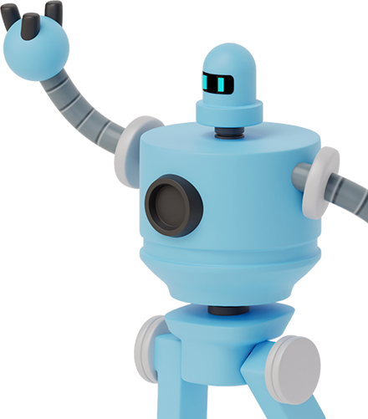
CICLO DE VIDA NELSON.BENITEZ@PASCUALBRAVO.EDU.CO

Slide 2
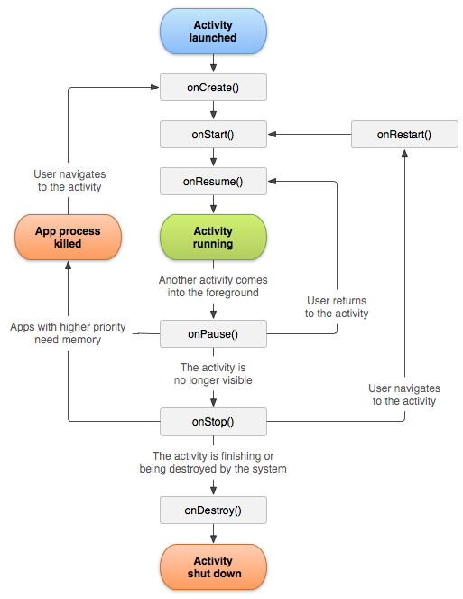


CICLO DE VIDA DE UNA ACTIVIDAD

Slide 3


CICLO DE VIDA
onCreate():
The onCreate() callback is compulsory in all Android applications. It is the first method called when we launch an activity from the home screen or intent. In other words, it is a default callback that is automatically created when you create a new activity.
onStart()
When an application is started, the system will invoke an onStart() method. This callback is invoked to make the activity visible to the user.

Slide 4
CICLO DE VIDA
onResume()
Once onStart() is called, onResume() is immediately invoked. Every component associated with this activity is brought to the foreground state.
At this point, the activity remains in the foreground state unless something happens to the application. This may include overly (multi-window mode application) interaction from other applications such as a phone call or when a user navigates to another activity.
onPause()
onPause() is called when the user switches to another activity or a multi-window mode application. At this point, the activity has lost focus and is running in the background.

Slide 5
CICLO DE VIDA
onStop()
At this point, most of the activity processes have been stopped. However, the activity is still running in the background.
This life-cycle usually occurs after the onPause() method is executed due to the user switching to other activities or pressing the home button.
Since onPause() is brief, onStop() can be used to save data to other channels such as databases.
When a user opens it again, the application will not reload all instances. Instead, it will retrieve them from memory. This includes UI components such as the TextViews.
Note: At this time, this activity is not destroyed yet. The activity instances are saved in a back stack. This means all stated are still active, including the views.
.

Slide 6
CICLO DE VIDA
onRestart()
Since the activity’s states still exist, the onRestart() method can be called when the user restarts the activity. This means the activity will go back to the main screen and the user can resume interacting with its components.
As discussed, the onCreate() function is only called once in an activity’s life-cycle. So, when the onRestart() method is executed, the activity will resume by executing the onStart() then onResume().

Slide 7
CICLO DE VIDA
onDestroy()
This is the final callback that the activity will receive when it is stopped.
The method is called when there is a change in the configuration states such as screen rotation or language settings. The Android system will destroy the activity, then recreate it with the set configurations.

Slide 8
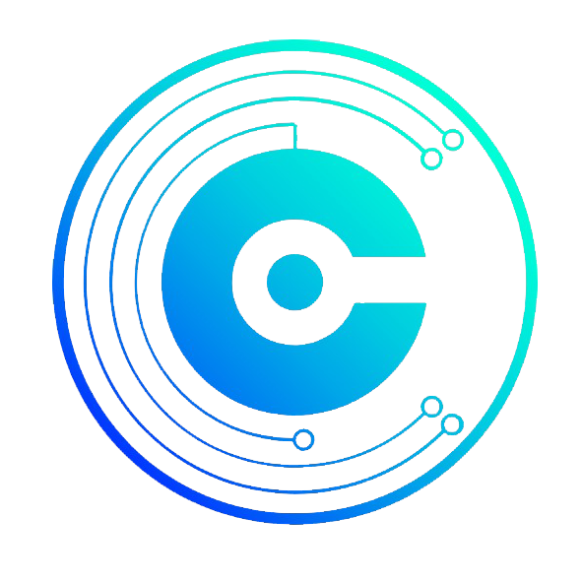
gracias!
ALGUNA DUDA? Puedes escribirme:
nelson.benitez@pascualbravo.edu.co

